Slide 1
Phase 2 - Project
AGENDA xc
Intro To Business & Opportunity
Methodology
3 Recommendations
Future Opportunities/ Next Steps
Notes:
In the first half of the presentation (2-3 mins), you should summarize your methodology in a way that will be comprehensible to someone with no background in data science and that will increase their confidence in you and your findings. In the second half (the remaining 2-3 mins) you should summarize your findings and be ready to answer a couple of non-technical questions from the audience. The questions might relate to technical topics (sampling bias, confidence, etc) but will be asked in a non-technical way and need to be answered in a way that does not assume a background in statistics or machine learning. You can assume a smart, business stakeholder, with a non-quantitative college degree.

Slide 2
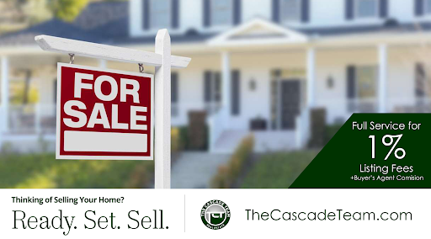

Business
King County
REALITY
Opportunity: Increase Revenue From Seller Commissions

Slide 3

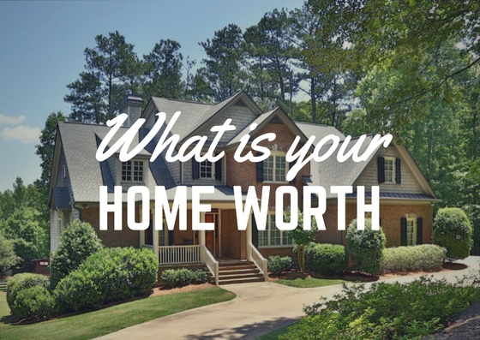

Idea!
1. Develop web-based program that generates the prices of home instantly
Becoming More Data Driven
2. Coaching Tool For Agents A. Help Sellers Increase The Value of Homes Prior To Sale
B. Set “Better” Prices – maximize sales prices
Notes:
So how are we going to do this? By becoming more data drive –
Understand what features help drive sale prices, so agents can become smarter coaches on how to help potential sellers increase they value of there homes by making suggestions on what makes the most impact
What data to use to set prices for there prospective sellers, with the hopes to maximize sales prices

Slide 4

Business Value
Short-term Increase Current Revenue
Marketing Campaign
Data Driven “Smarter” Agents
Higher Sales Prices
Fewer Days On Market
Notes:
Before settling on a pricing strategy, your agent will do a Comparative Market Analysis (CMA) to evaluate recent and historical home sale trends in your area. Then they’ll assess the various factors like location, condition, updates and current competition before they recommend a list price.
https://www.homelight.com/blog/how-to-set-list-price/

Slide 5
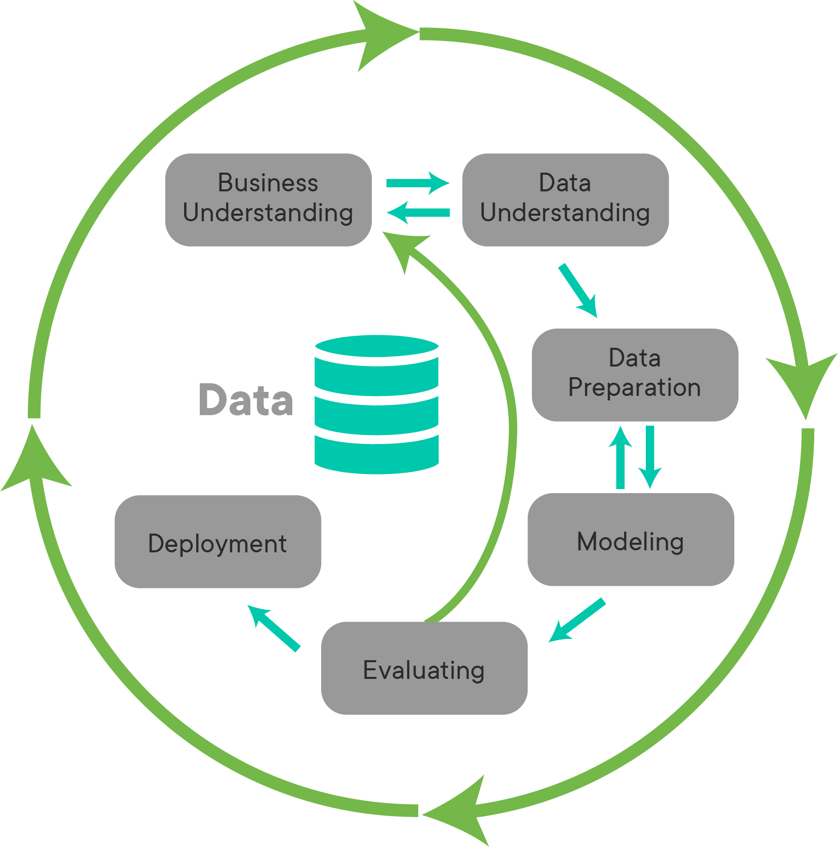


Methodology
3 Recommendations
1 – Physical Factors - “controllable”
2 – Location Factor - “influenceable”
3 – Setting “Better” Prices…Looking beyond CMA
Notes:
For Model Creation and Coaching Agents on Factors That Drive Sales Price… I am going to confirm the credibility of the CMA factors… show you the factors that had the most impact on my model and how influencing those factors can impact price. but then I am going make a recommendation Beyond CMA… what if Comparable are not available? I am going to show data that in my model shows this data is more impactful in predicting sales prices than the CMA features, which can be used by agents to help client maximize the price they set for there homes… all of these in turn will increase revenue from seller commissions.
How do real estate agents typically set prices, and what factors do they use to coach perspective sellers.
Before settling on a pricing strategy, your agent will do a Comparative Market Analysis (CMA) to evaluate recent and historical home sale trends in your area. Then they’ll assess the various factors like location, condition, updates and current competition before they recommend a list price.
https://www.homelight.com/blog/how-to-set-list-price/

Slide 6
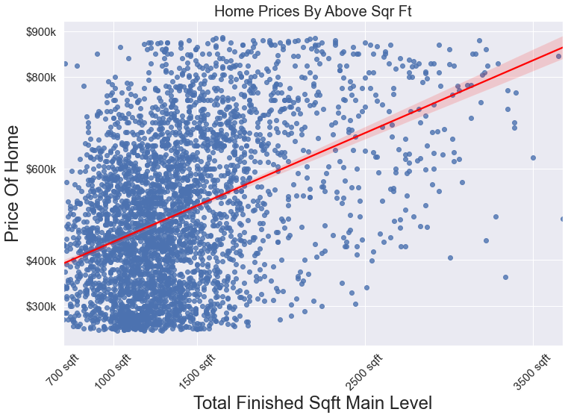
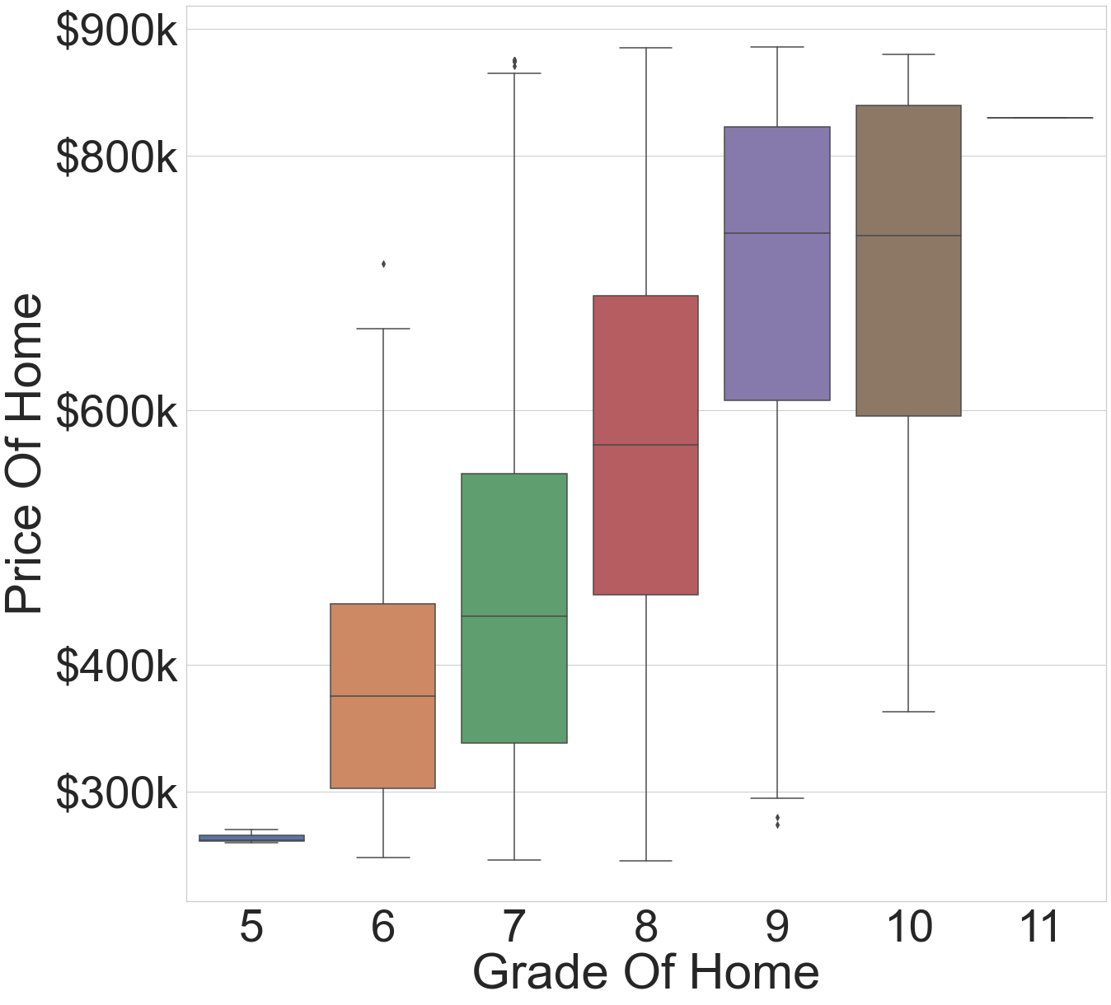
Recommendation -1 Augmenting “Controllable” Features
# Main-Level Finished Square Feet
Opportunity to add hue - > 1000 basement, less
Grade “Specialness” of Home
100 Additional Square Feet = Increase in price by ~ $4000 increase in sale price
On Average, improving grade by one increment can lead to over $22K increase in home prices
$362,807
$366,606
1382 ft
1482ft
$362,807
$385454
Grade 7
Grade 8
Sadv
Notes:
So my first recommendation to Agents who are working with sellers in terms of trying to maximize sales price is to focus on the above two physical features. Given the data we had available, these two features had the most predictive power. For every increase I 100 sqr footage – x happens, and any thing we can do to improve condition… changing a homes from condition 3 → 4 had the following impact

Slide 7
Recommendation 2 – Augmenting “Influenceable” Factors
School District
?
Average price per square foot based on school district – Box plot
Changing the bracket your school district is in can lead to an increase in $160k in home price

Slide 8
Recommendation 3 – Setting “Better” Prices
Comparative Market Analysis (CMA)
- Home Features, Condition, Location, Competition
- Power Of Home “features” In Predicting Value of Home
Insert Gage
- Power Of Location “features” In Predicting Value of Home
Insert Gage
- Power Of Previous Assessor Appraisals
Insert Gage
Can we predict assessor values using our model?
?
Adding Assessor Values
?

Slide 9

Future Work/ Next Steps
Augment “Mainstream” Model
Study data with greatest outliers
Develop additional models for more niche customers
(<$200k, >$800k)
Develop range estimates (2 standard deviations on both sides of point estimate)
Based on accuracy look to offer promotions to home sellers that use the tool.
If you can’t sell home within quoted range, offer xyz

Slide 10

Thanks For Your Time and Consideration!

Slide 11



Model Results:
Plot actual vs. predicted
Measures - goodness-of-fit - 83% of our predicted price can be explained by our model features, 17% may be cause by random error
“Does This Mean?”
Things that did not make the cut?
attractions,
Under 10 miles
Rooms
Zip code hotness score
???
Waterfront… model
Show predicted vs. actual plot
Notes:
Bias in the model - If the expected value of the estimator equals the population parameter, the estimator is an unbiased estimator.
If the expected value of the estimator does not equal the population parameter, it is a biased estimator.
coefficient estimates and predicted values can have larger margins of error around them. That’s why you don’t want to include too many terms in the regression model!

Slide 12
Appendix

Slide 13
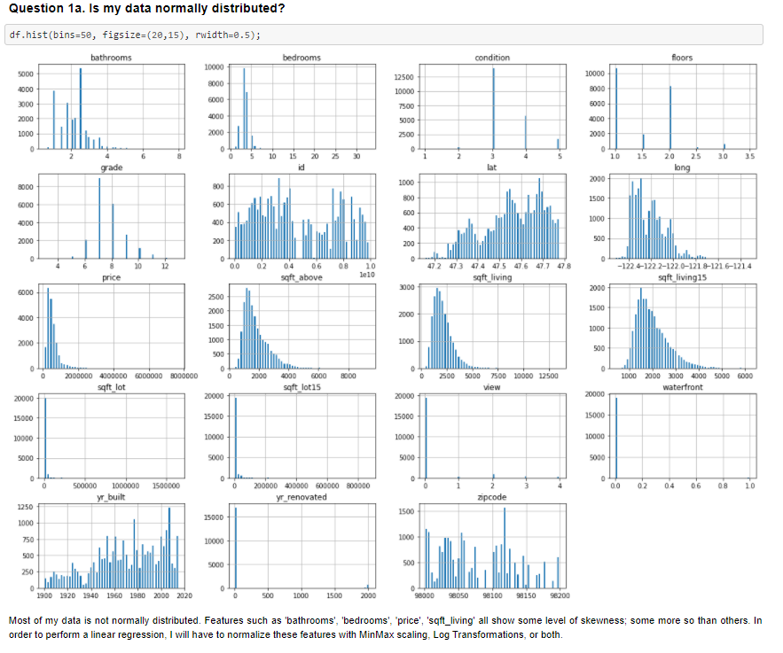
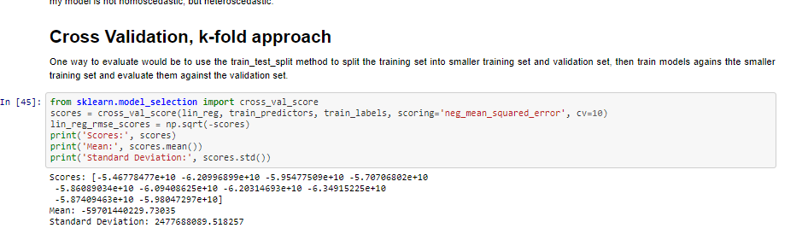
Changes to my models – note book

Slide 14
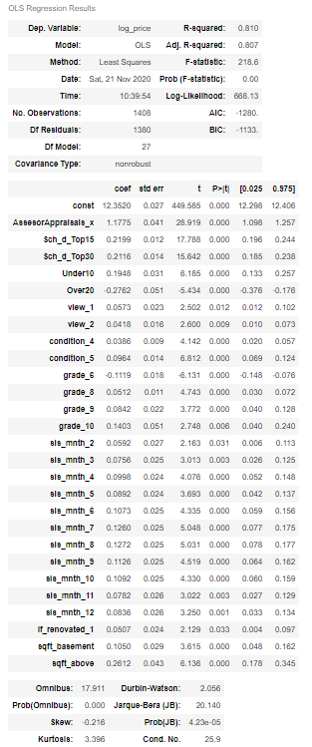
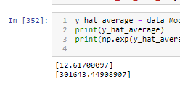
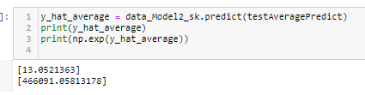
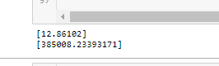
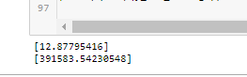
Averages Model 2
School dist = top 60
School dist = top 30
Averages Model 1
Additional 100 sqft

Slide 15
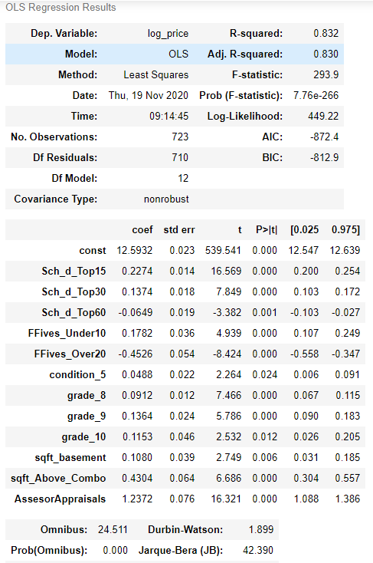
Questions to Amber
How would use the model… say impact of more rooms or sqr footage
How to use Lat, Long?
Other misc questions
Comments in Commits
Talk to each model…
Explain what each model means and does…
How do I connect you to my github?
Look to increase investing in schools,
Selling homes in districts school districts that have higher ranked schools
Support the growth of entering companies and especially larger companies
Make recommendation on grade and condition
Add Square footage to Main Living
Look to build relationships with Assessors, understand what goes into there evaluations and when changes are happening as this will have a big impact on sale price

Slide 16
Ideas On Recommendations
Target Market – most frequent home features – Frequency of features
When to rollout tool –
Right Before best sales of month (most frequent month, month of highest predicted values)
What data “features” makes the most impact to model
Physical – Covered
Location, location, location – how would demonstrate – multiple factors added?
Previous valuations…
How Else can we use the tool?
Make agents “smarter”
When to sell
Month
Age of Home? – Price Per Square foot
Impact of Renovations
Do they have impact – average price of homes with renovations vs. without
Price Per Square foot with reno, vs without

Slide 17
Methodology
“I NEED 3 RECCOMMENDATIONS On How My Agents Can Coach Prospective Buyers On How To Ince!”
Notes:
What’s for dinner toning?
Understand Housing Data
Select Demographics That Maximize Reach
Mass Market vs. Niche
Alignment with Business Strategy
Develop Predictive Models Iteratively
Initial model focused on middle 85% of homes prices
Find features that help predict values accurately
Understand Housing Data
Select Demographics That Maximize Reach
Mass Market vs. Niche
Alignment with Business Strategy
Develop Predictive Models Iteratively
Initial model focused on middle 85% of homes prices
Find features that help predict values accurately
Future opportunities to develop models for “niche” customers
Future opportunities to develop models for “niche” customers

Slide 18

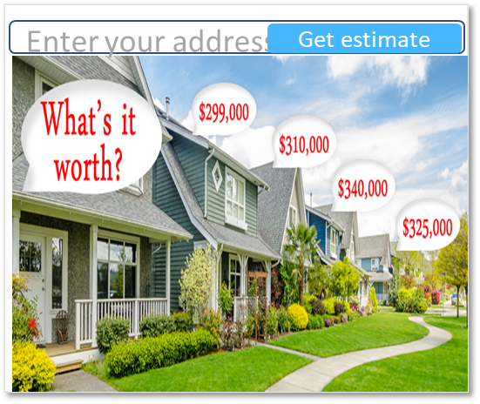
Idea!
Develop web-based program that generates the prices of home instantly
How?
A New Marketing Campaign Called…
WHATS IT WORTH!
Notes:
Becoming top of mind to potential sellers, Increase Brand Awareness With Prospective Sellers!

Slide 19
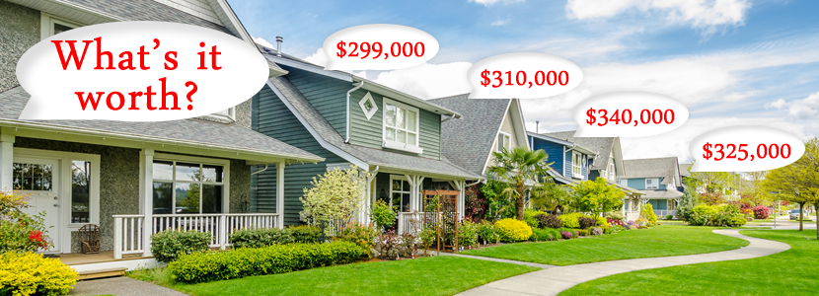
Example:
1. Example 1
Enter your address
Get estimate
2. Example 2
3. Example - Less Accurate

Slide 20
Methodology
“…Oh Yea and make sure to Maximize Reach!”
Business Strategy
“Mainstream
Sellers”
“I NEED 3 RECCOMMENDATIONS!”
Can we do this with one model?
If not, who should we target?
What data do we need?
Notes:
What’s for dinner toning?
Understand Housing Data
Select Demographics That Maximize Reach
Mass Market vs. Niche
Alignment with Business Strategy
Develop Predictive Models Iteratively
Initial model focused on middle 85% of homes prices
Find features that help predict values accurately
Understand Housing Data
Select Demographics That Maximize Reach
Mass Market vs. Niche
Alignment with Business Strategy
Develop Predictive Models Iteratively
Initial model focused on middle 85% of homes prices
Find features that help predict values accurately
Future opportunities to develop models for “niche” customers
Future opportunities to develop models for “niche” customers

Slide 21
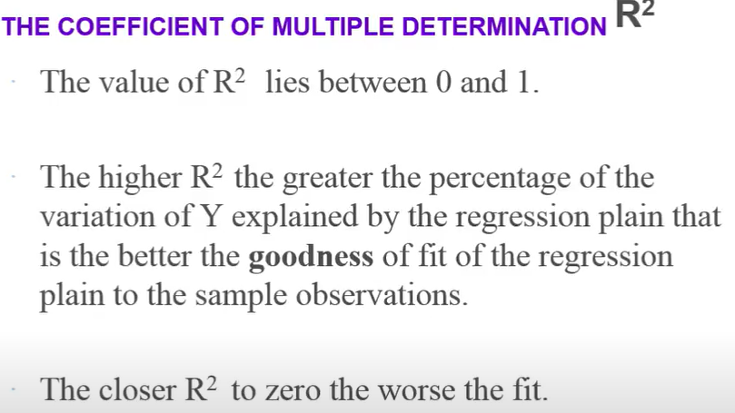
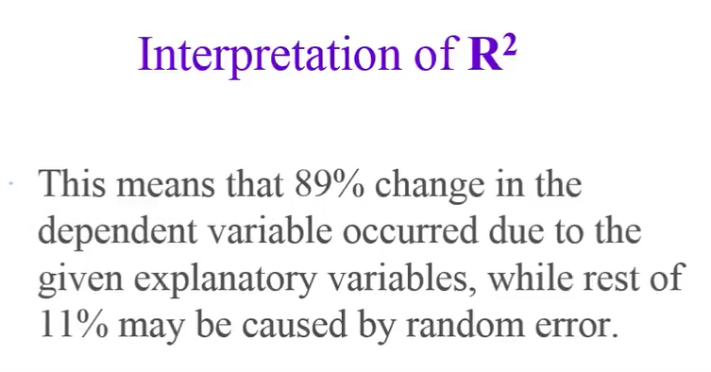
Explanation of Adjust R2

Slide 22
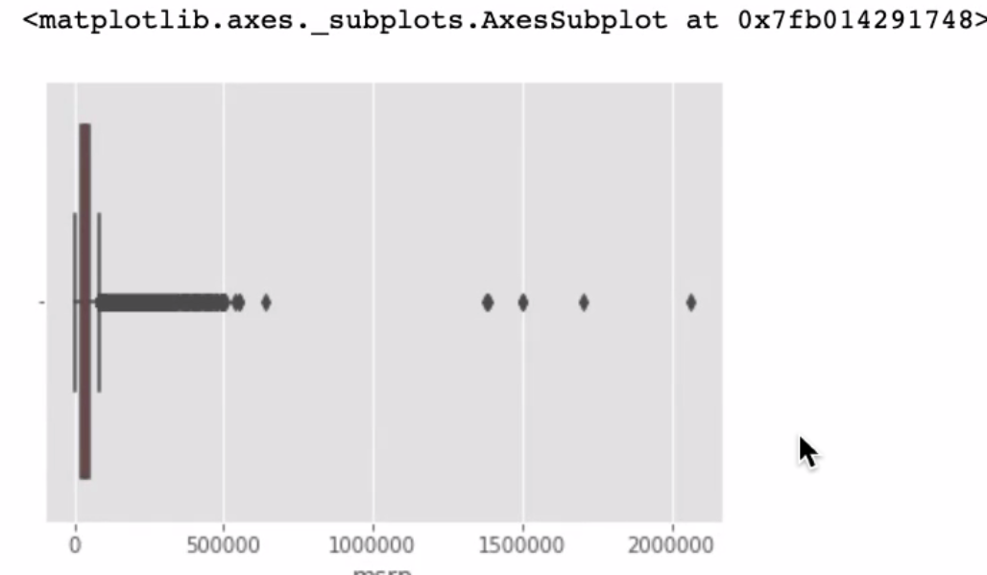
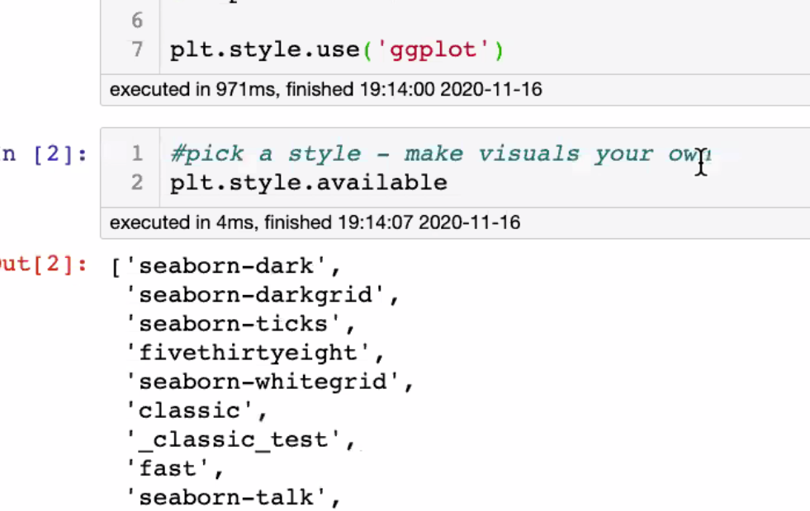
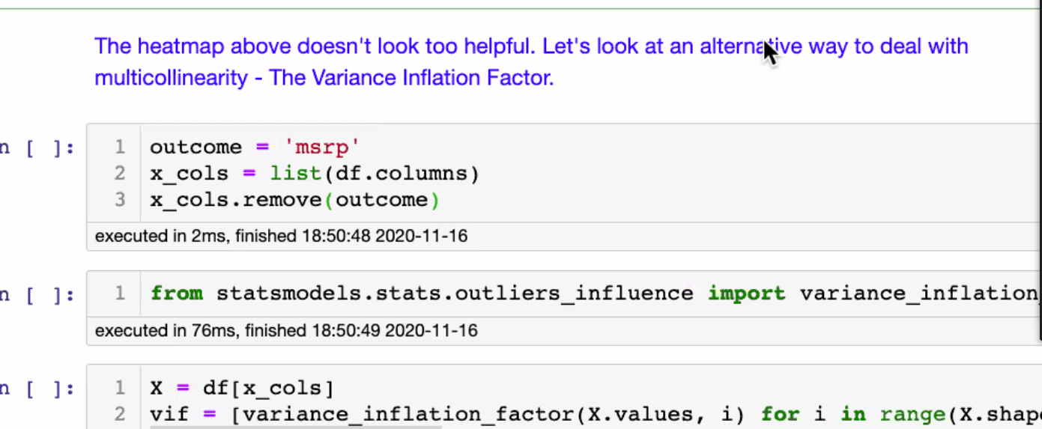
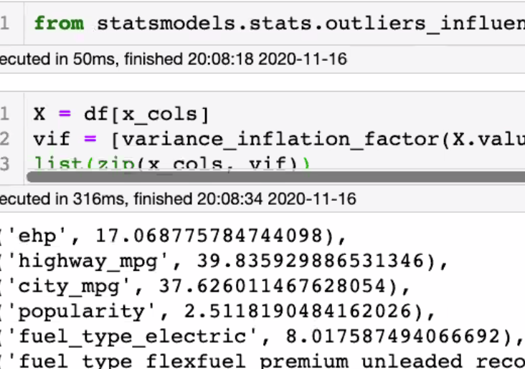
Vif < 10

Slide 23
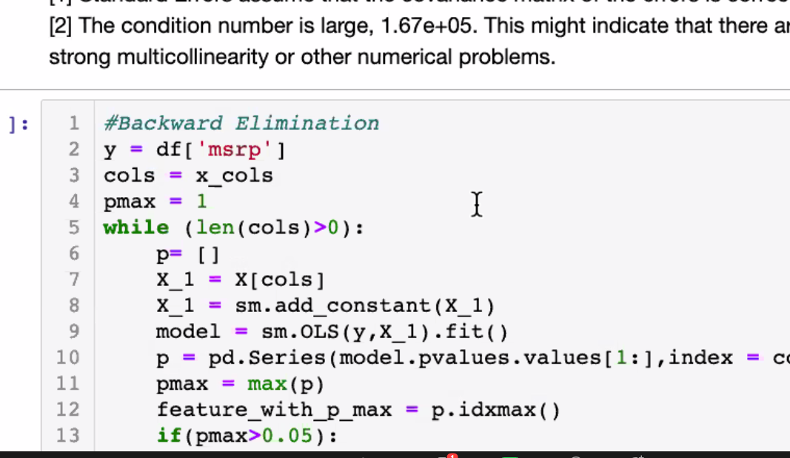
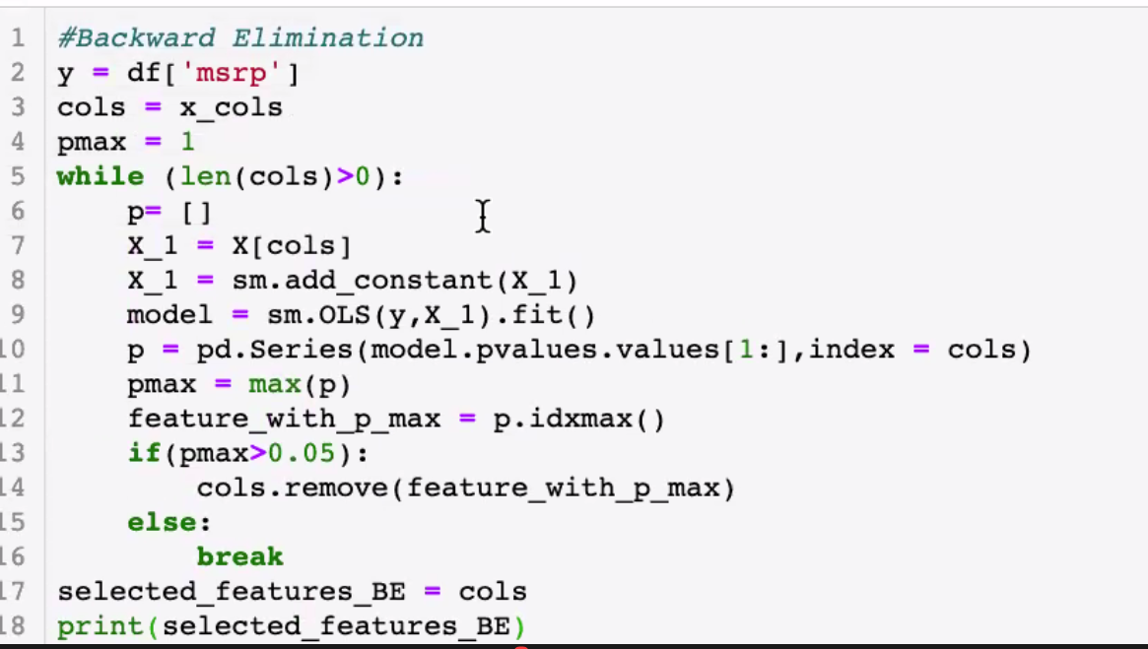
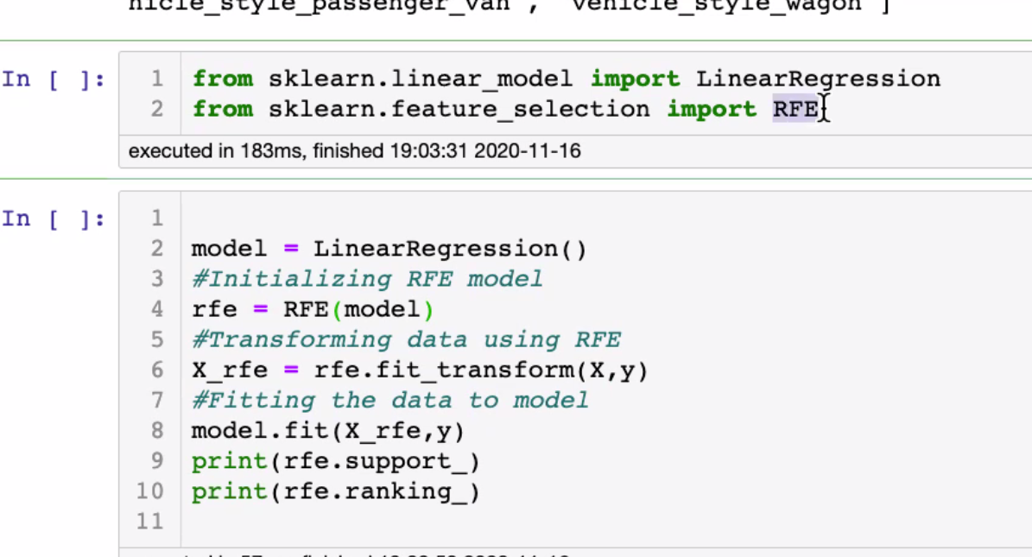
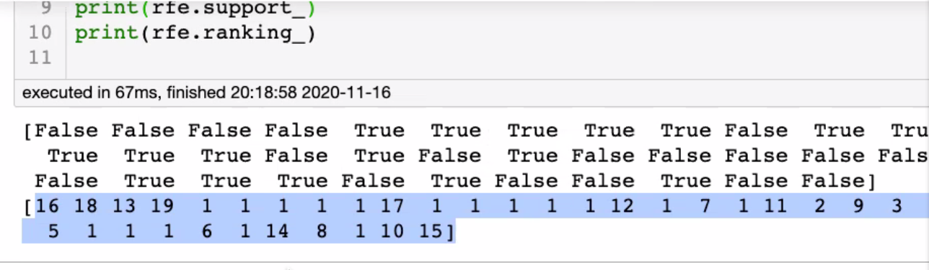
To eliminate - features
Normalization – changing shape
Wk 6 – mod 2
Bias Variance Trade off,
Mse should be almost the same .1 or . 2 difference
Keep trues

Slide 24
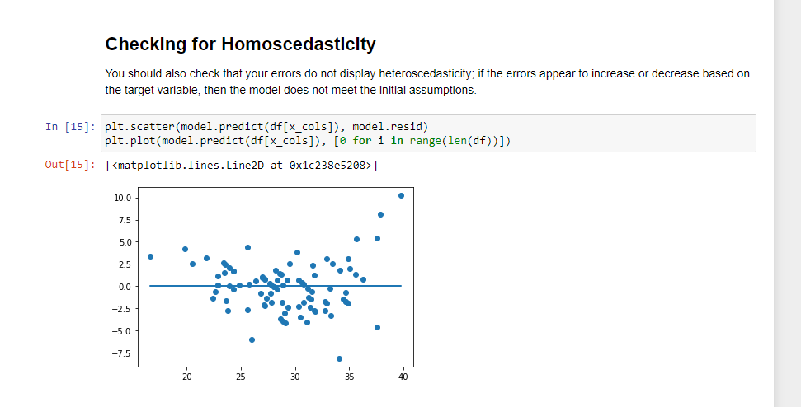
Check for homo scadicity, eliminate the no value features, create dummy variables for school district ranking,
Read again the deliverables for the presentation part….

Slide 25
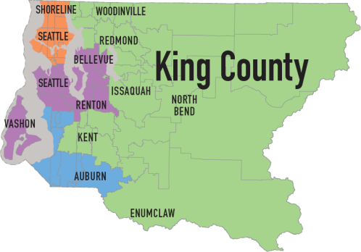
Problem statement, business
value, methodology, business
recommendations (each
recommendation on a separate
slide), future work/next steps.
Thank You Slide is
present. Appendix
includes additional work.

Slide 26
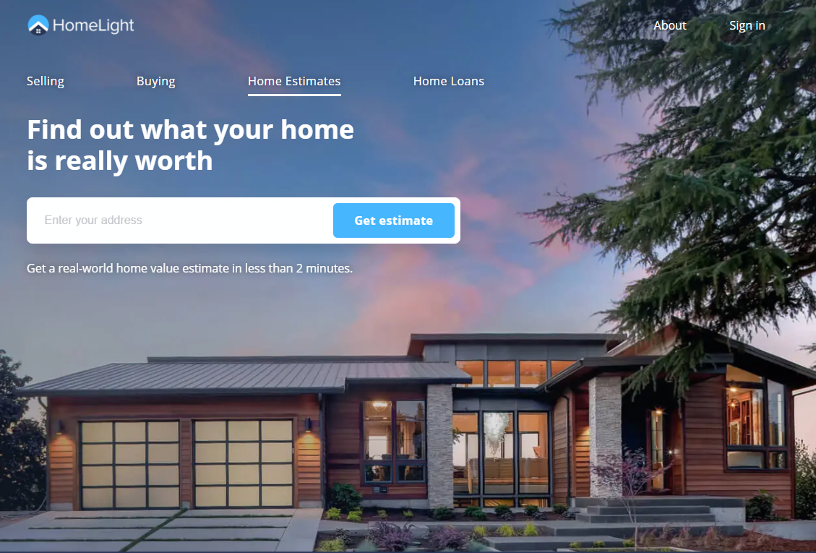
Business Opportunity: Auto Generated Estimated Sales Price

Slide 27

Business Opportunity

Slide 28
Business Opportunity

Slide 29
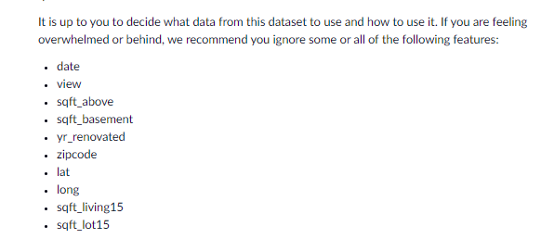
https://www.dataquest.io/blog/kaggle-getting-started/
https://www.youtube.com/watch?v=p_tpQSY1aTs
# Column Names and descriptions for Kings County Data Set
* **id** - unique identified for a house
* **dateDate** - house was sold
* **pricePrice** - is prediction target
* **bedroomsNumber** - of Bedrooms/House
* **bathroomsNumber** - of bathrooms/bedrooms
* **sqft_livingsquare** - footage of the home
* **sqft_lotsquare** - footage of the lot
* **floorsTotal** - floors (levels) in house
* **waterfront** - House which has a view to a waterfront
* **view** - Has been viewed
* **condition** - How good the condition is ( Overall )
* **grade** - overall grade given to the housing unit, based on King County grading system
* **sqft_above** - square footage of house apart from basement
* **sqft_basement** - square footage of the basement
* **yr_built** - Built Year
* **yr_renovated** - Year when house was renovated
* **zipcode** - zip
* **lat** - Latitude coordinate
* **long** - Longitude coordinate
* **sqft_living15** - The square footage of interior housing living space for the nearest 15 neighbors
* **sqft_lot15** - The square footage of the land lots of the nearest 15 neighbors
https://www.youtube.com/watch?v=vtm35gVP8JU
https://www.youtube.com/watch?v=Qq2X-K2Ku3s
https://www.kaggle.com/shivachandel/kc-house-data/notebooks

Slide 30
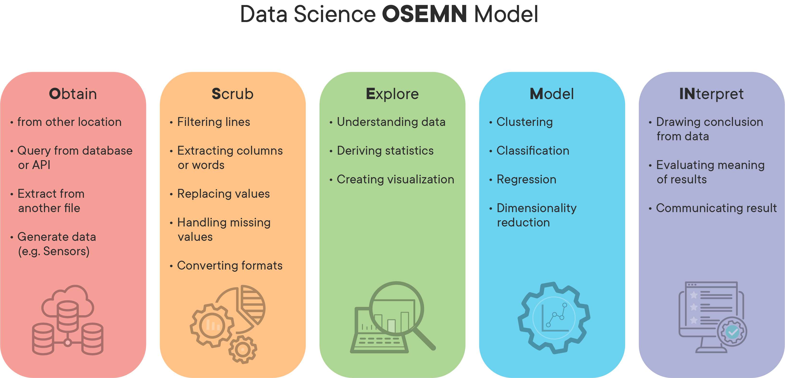
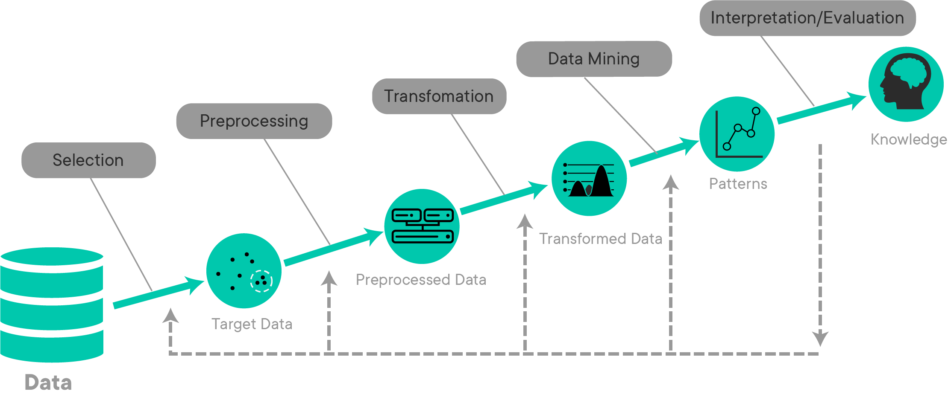
provide advice to homeowners about how home renovations might increase the estimated value of their homes, and by what amount.
# Column Names and descriptions for Kings County Data Set
* **id** - unique identified for a house
* **dateDate** - house was sold
* **pricePrice** - is prediction target
* **bedroomsNumber** - of Bedrooms/House
* **bathroomsNumber** - of bathrooms/bedrooms
* **sqft_livingsquare** - footage of the home
* **sqft_lotsquare** - footage of the lot
* **floorsTotal** - floors (levels) in house
* **waterfront** - House which has a view to a waterfront
* **view** - Has been viewed
* **condition** - How good the condition is ( Overall )
* **grade** - overall grade given to the housing unit, based on King County grading system
* **sqft_above** - square footage of house apart from basement
* **sqft_basement** - square footage of the basement
* **yr_built** - Built Year
* **yr_renovated** - Year when house was renovated
* **zipcode** - zip
* **lat** - Latitude coordinate
* **long** - Longitude coordinate
* **sqft_living15** - The square footage of interior housing living space for the nearest 15 neighbors
* **sqft_lot15** - The square footage of the land lots of the nearest 15 neighbors

Slide 31
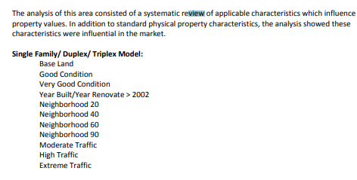
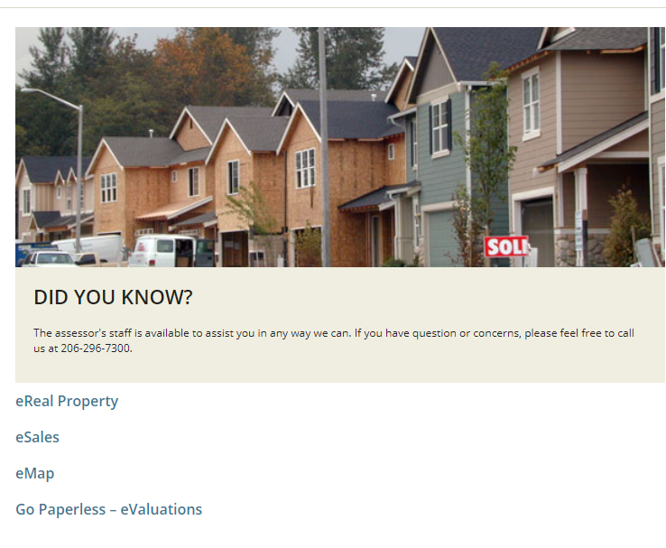
View amenities - including Seattle Skyline, Lake Washington, and Small Lake River (Lake Union) views
Single Family/ Duplex/ Triplex Model:
Base Land
Good Condition
Very Good Condition
Year Built/Year Renovate > 2002
Neighborhood 20
Neighborhood 40
Neighborhood 60
Neighborhood 90
Moderate Traffic
High Traffic
Extreme Traffic
Improved Parcel Valuation… Continued
Area 013 19
2017 Physical Inspection Department of Assessments
Townhouse Dwellings:
Base Land
Neighborhood 80
There was a lack of sales

Slide 32
assessor.info@kingcounty.gov
Vacant sales from 1/1/2014 to 12/31/2016 were given primary consideration for valuing land with emphasis placed on those sales closest to January 1, 2017. Area 013 contains 4,459 parcels of which approximately 3% are vacant.
Location, views, zoning, topography, lot size and traffic are primary influences to land values.

Slide 33
https://info.kingcounty.gov/assessor/esales/Glossary.aspx?type=r#g
BUILDING CONDITION
 | Relative to age and grade. Coded 1-5. 1 = Poor- Worn out. Repair and overhaul needed on painted surfaces, roofing, plumbing, heating and numerous functional inadequacies. Excessive deferred maintenance and abuse, limited value-in-use, approaching abandonment or major reconstruction; reuse or change in occupancy is imminent. Effective age is near the end of the scale regardless of the actual chronological age. 2 = Fair- Badly worn. Much repair needed. Many items need refinishing or overhauling, deferred maintenance obvious, inadequate building utility and systems all shortening the life expectancy and increasing the effective age. 3 = Average- Some evidence of deferred maintenance and normal obsolescence with age in that a few minor repairs are needed, along with some refinishing. All major components still functional and contributing toward an extended life expectancy. Effective age and utility is standard for like properties of its class and usage. 4 = Good- No obvious maintenance required but neither is everything new. Appearance and utility are above the standard and the overall effective age will be lower than the typical property. 5= Very Good- All items well maintained, many having been overhauled and repaired as they have shown signs of wear, increasing the life expectancy and lowering the effective age with little deterioration or obsolescence evident with a high degree of utility.

Slide 34
BUILDING GRADE
 | Represents the construction quality of improvements. Grades run from grade 1 to 13. Generally defined as: 1-3 Falls short of minimum building standards. Normally cabin or inferior structure. 4 Generally older, low quality construction. Does not meet code. 5 Low construction costs and workmanship. Small, simple design. 6 Lowest grade currently meeting building code. Low quality materials and simple designs. 7 Average grade of construction and design. Commonly seen in plats and older sub-divisions. 8 Just above average in construction and design. Usually better materials in both the exterior and interior finish work. 9 Better architectural design with extra interior and exterior design and quality. 10 Homes of this quality generally have high quality features. Finish work is better and more design quality is seen in the floor plans. Generally have a larger square footage. 11 Custom design and higher quality finish work with added amenities of solid woods, bathroom fixtures and more luxurious options. 12 Custom design and excellent builders. All materials are of the highest quality and all conveniences are present. 13 Generally custom designed and built. Mansion level. Large amount of highest quality cabinet work, wood trim, marble, entry ways etc.

Slide 35
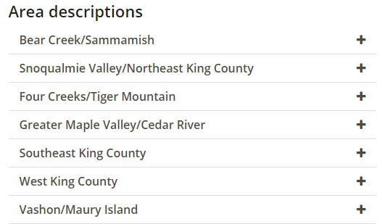

Slide 36
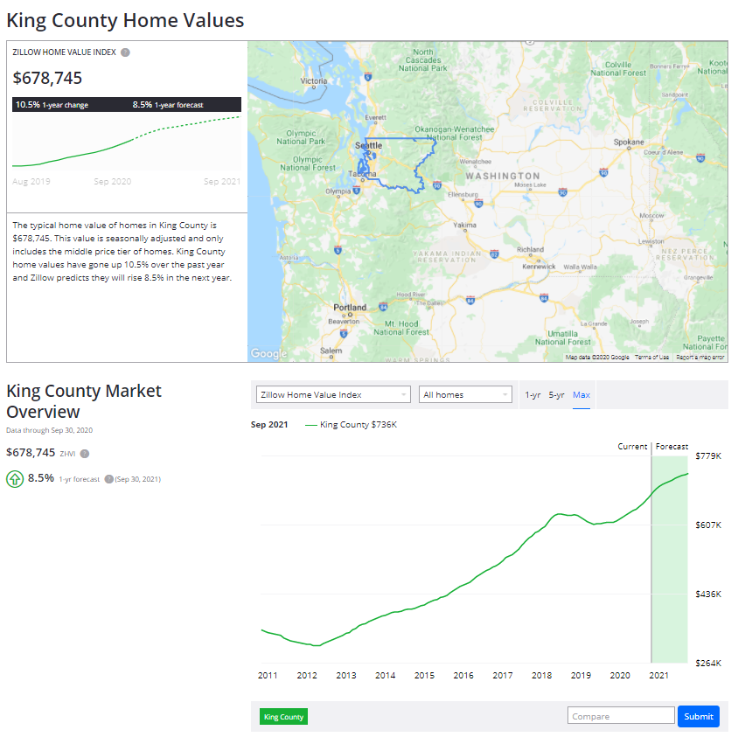
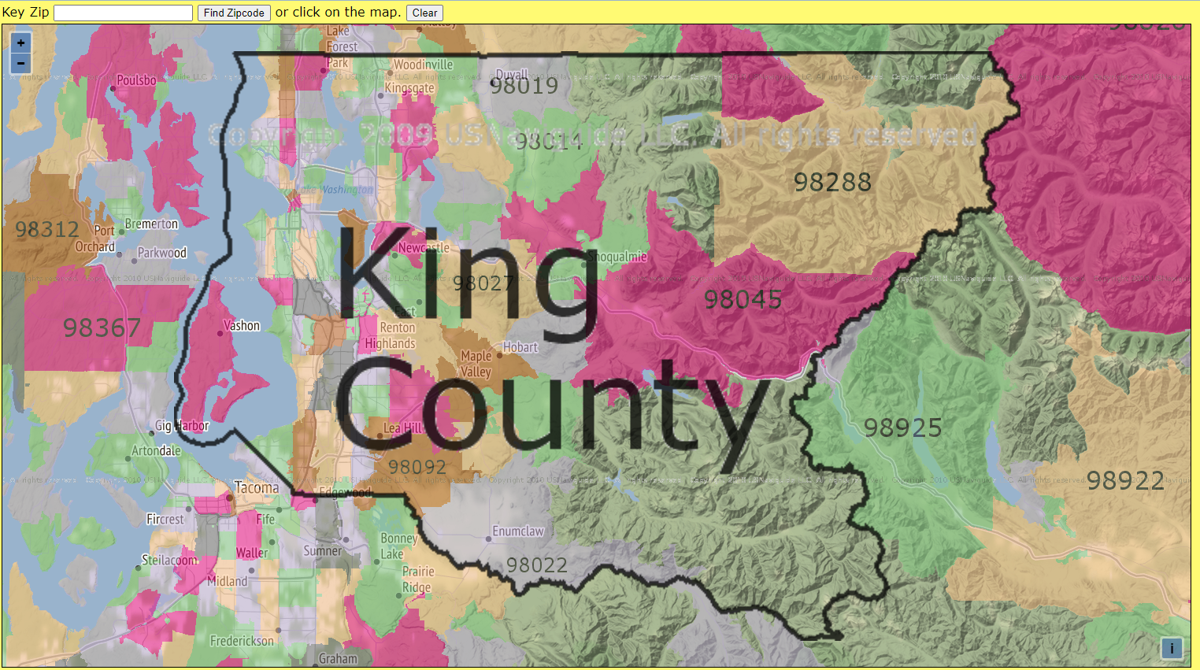
https://www.zipmap.net/Washington/King_County.htm

Slide 37
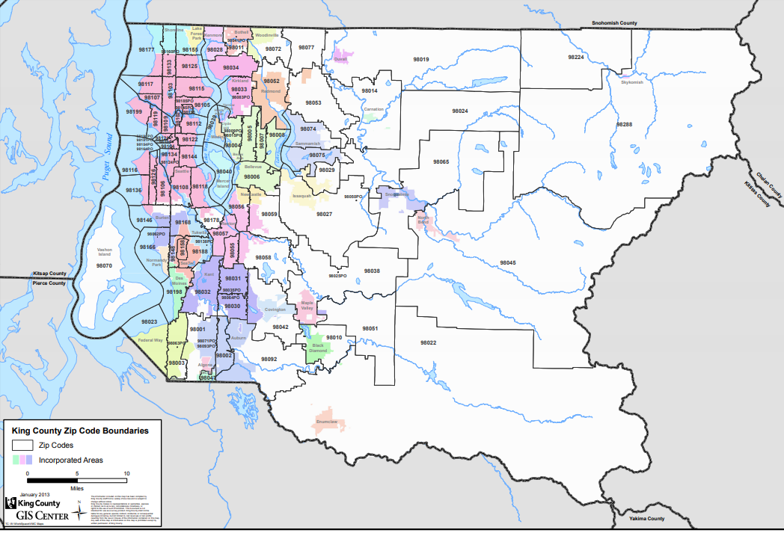
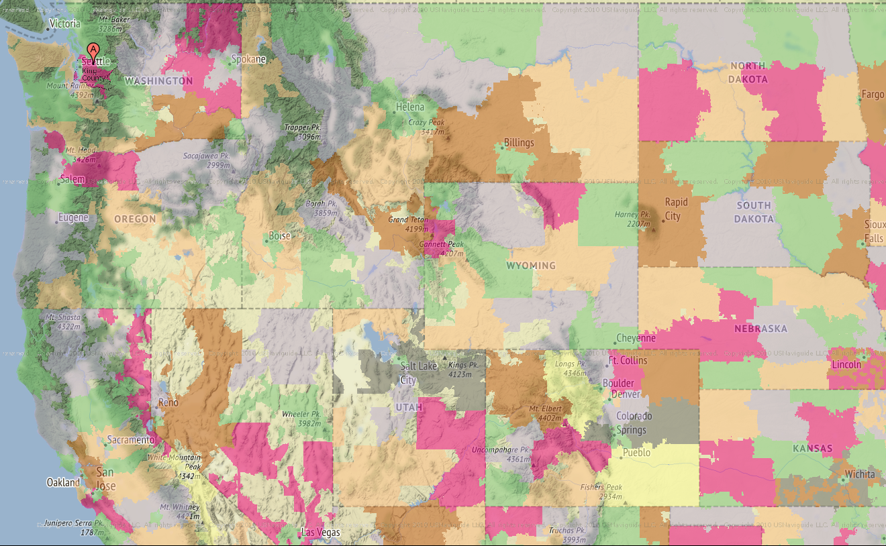
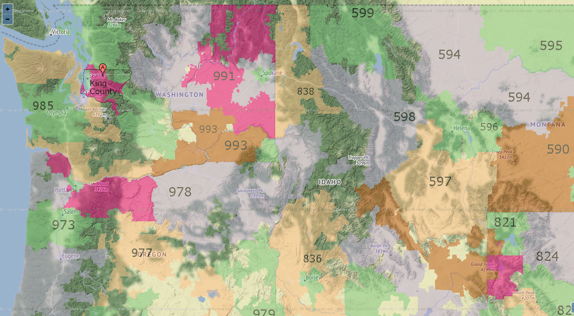
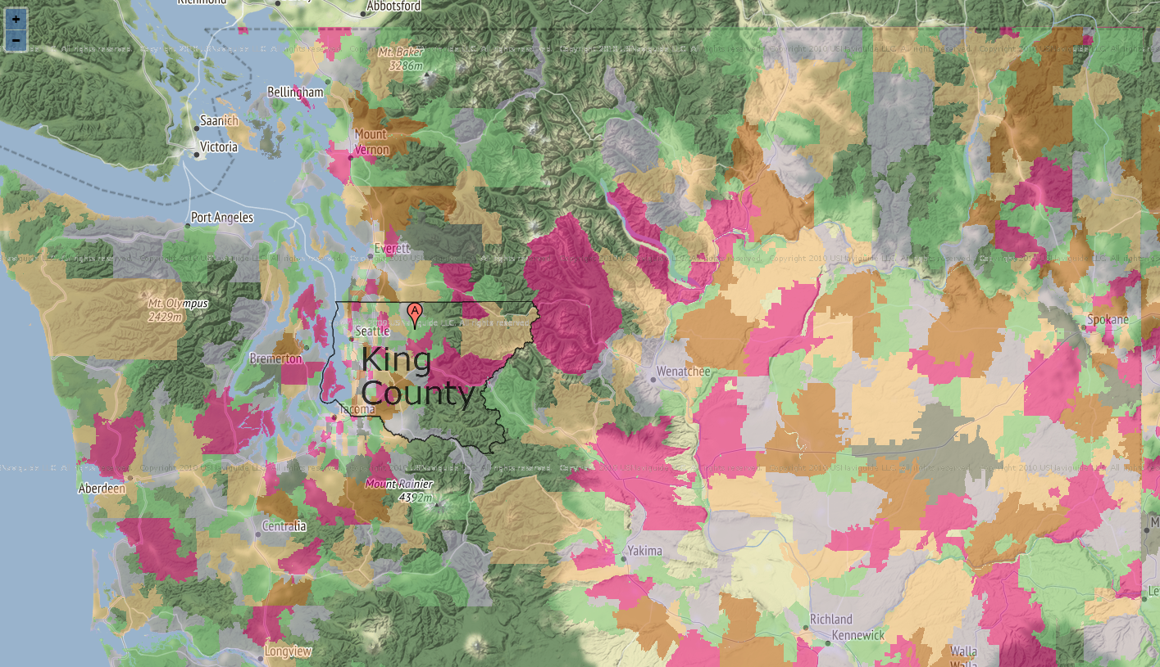
Area Code: 425

Slide 38
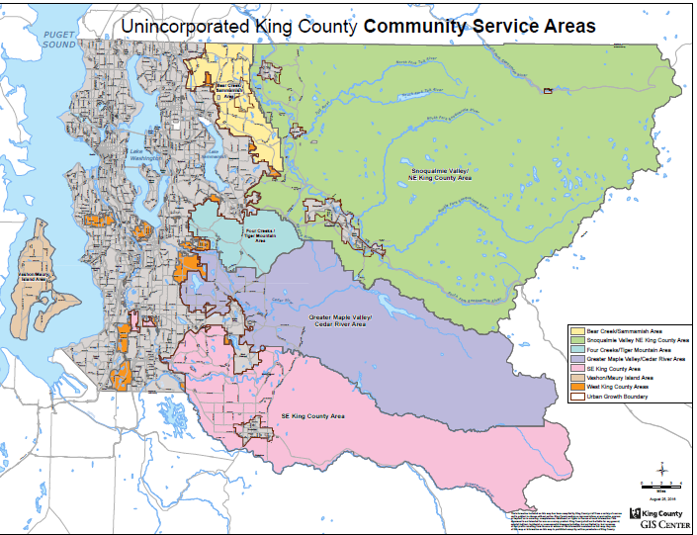

Slide 39
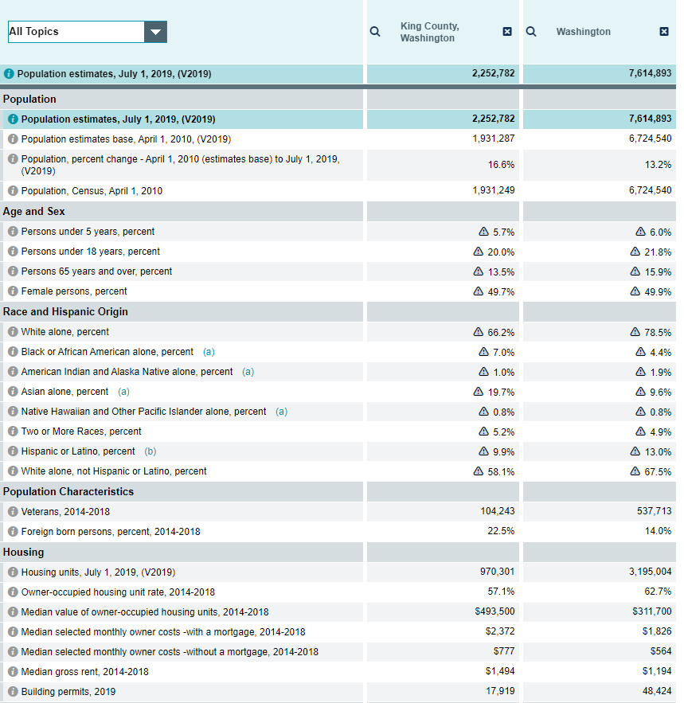
https://datausa.io/profile/geo/king-county-wa#housing

Slide 40
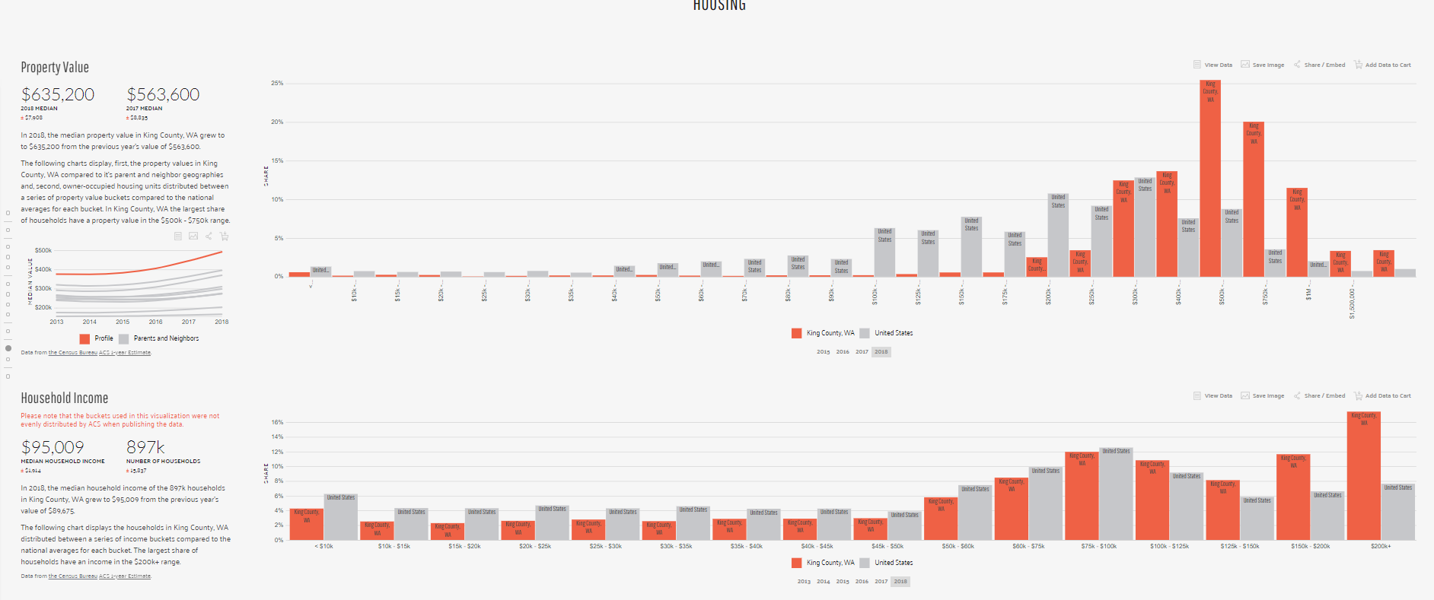

Slide 41
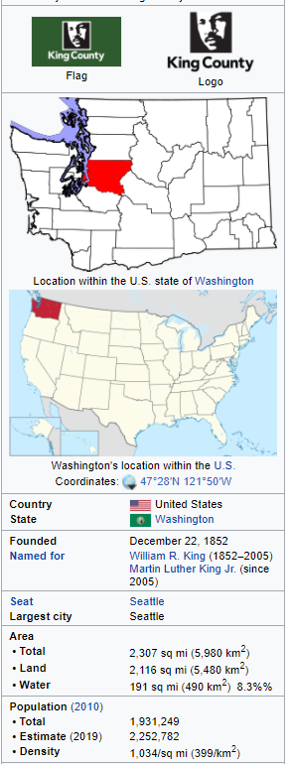

Slide 42
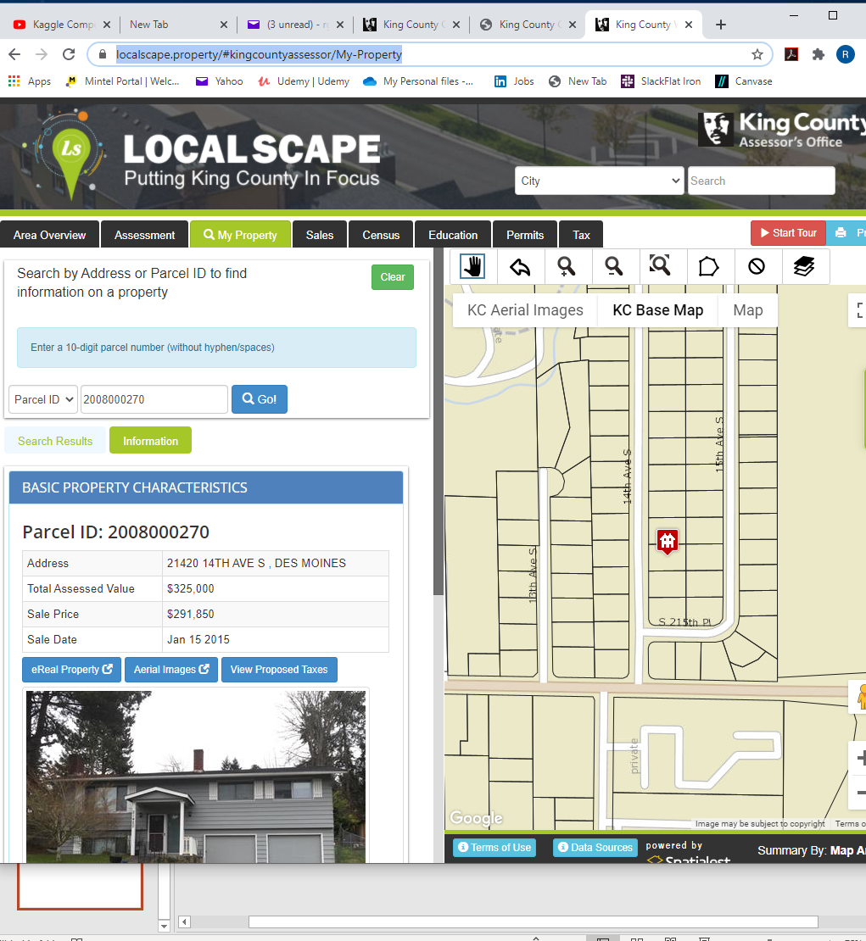
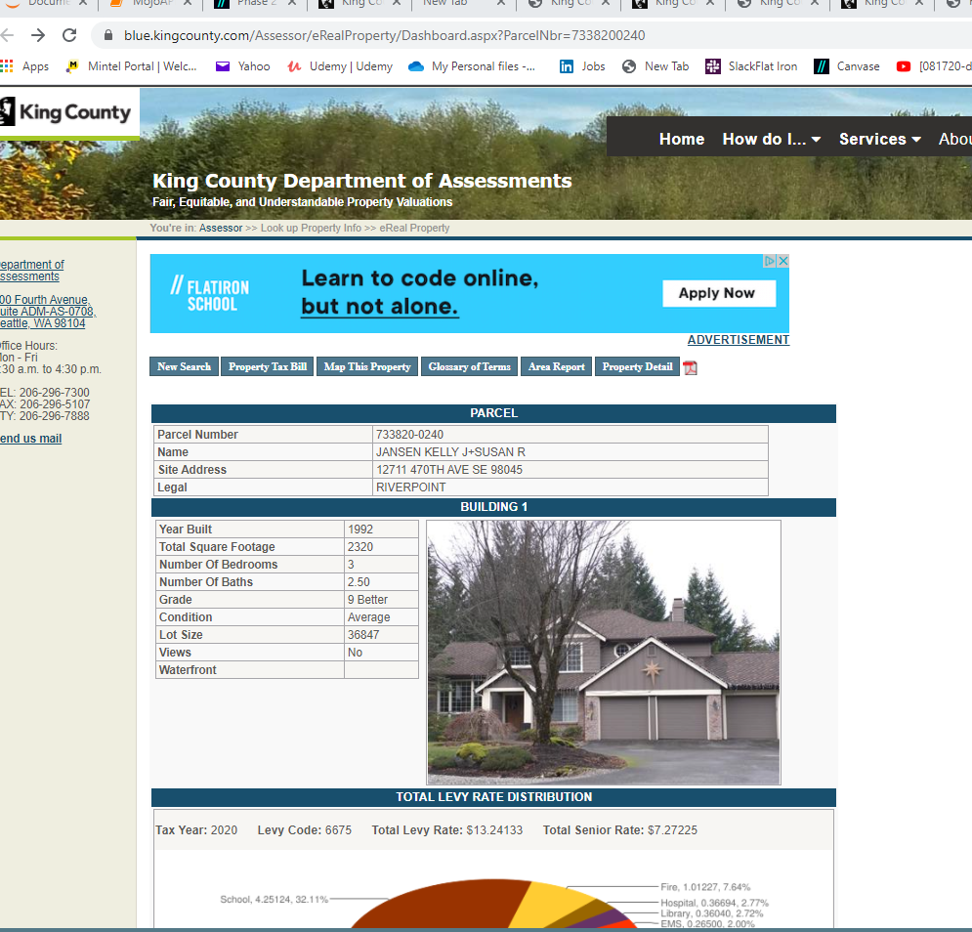
https://blue.kingcounty.com/Assessor/eRealProperty/Dashboard.aspx?ParcelNbr=7338200240
https://localscape.property/#kingcountyassessor/My-Property

Slide 43
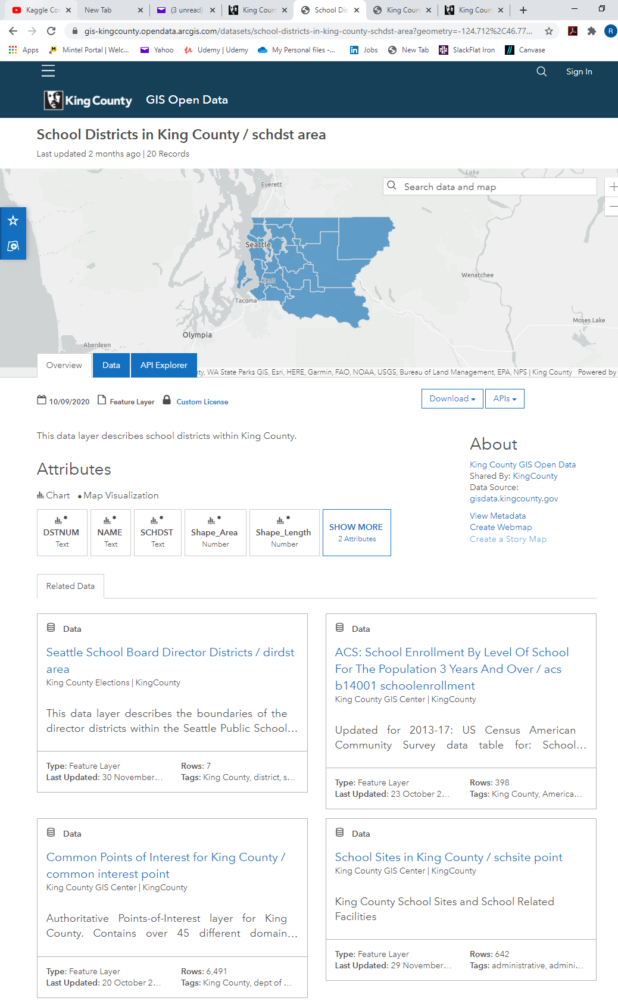
https://gis-kingcounty.opendata.arcgis.com/datasets/school-districts-in-king-county-schdst-area?geometry=-124.712%2C46.778%2C-118.873%2C48.079
https://www.kingcounty.gov/depts/assessor.aspx
https://gis-kingcounty.opendata.arcgis.com/datasets/common-points-of-interest-for-king-county-common-interest-point

Slide 44
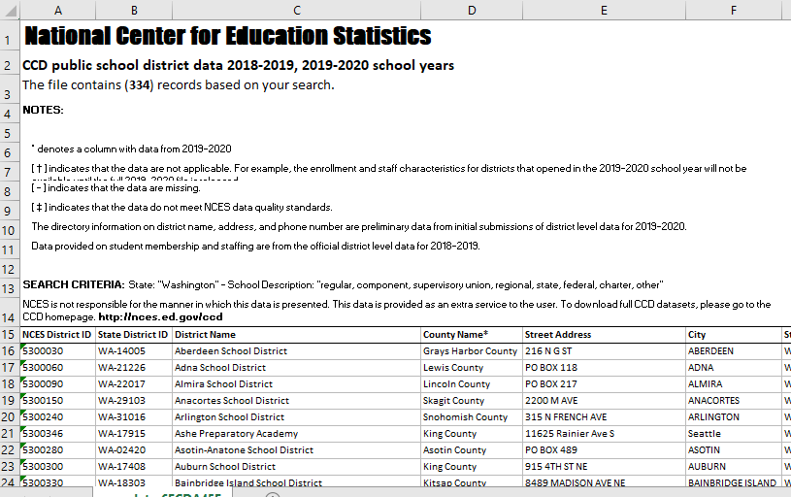
https://nces.ed.gov/ccd/districtsearch/district_list.asp?Search=1&details=1&InstName=&DistrictID=&Address=&City=&State=53&Zip=&Miles=&County=&PhoneAreaCode=&Phone=&DistrictType=1&DistrictType=2&DistrictType=3&DistrictType=4&DistrictType=5&DistrictType=6&DistrictType=7&DistrictType=8&NumOfStudents=&NumOfStudentsRange=more&NumOfSchools=&NumOfSchoolsRange=more

Slide 46
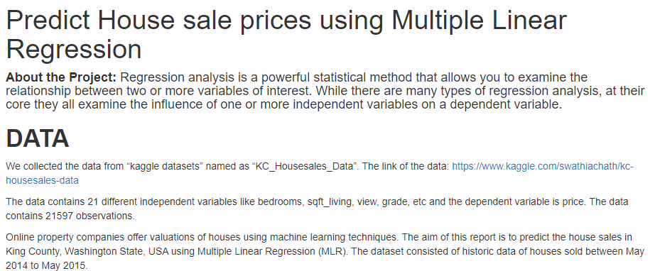
http://rstudio-pubs-static.s3.amazonaws.com/492324_a794047954284fdbbb5efd0631be458c.html

Slide 47
Questions
Categorical values – grade, view, waterfront, condition
Non continuous…
Continuous – sqft, rms, floors, yr renovated?
Scraping –
Business problem – Factors most correlated to getting more than appraised…actual vs. appraisal
Order
Missing values – strategy
categorical

Slide 48
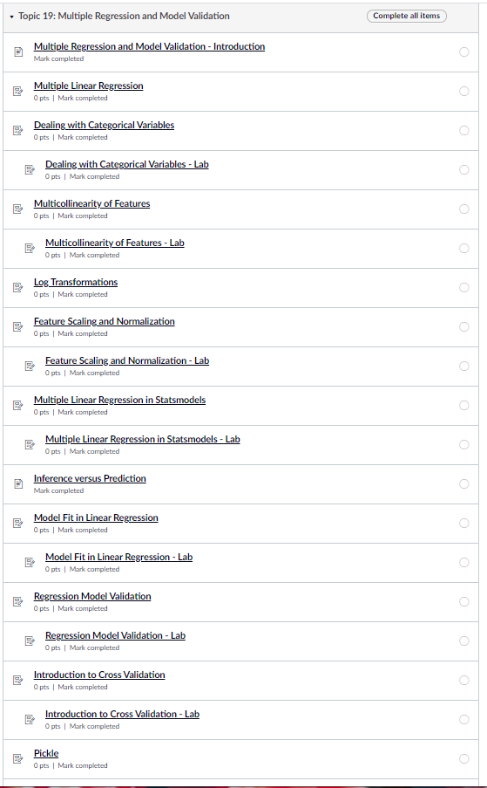
Missing values
Strategy – drop or fill – mode()[0]
Linearity Assumptions
linearity relationship
2. Determine categorical – one hot – hist, scatter vs dependent
1. - Multicollinearity – drop required – Heat and .corr
3. standardize –, reduce - Outliers impact - zscore
Split into training, vs test -
Model creation – Statsmodel (ols) & sklearn (LinearRegression), - step wise/ feature ranking
- Homodasticity? – Scatter = Cone Shape – QQ-plots
Model validation – Adj r2 and

Slide 49



sns.pairplot

Slide 50

https://towardsdatascience.com/regression-using-sklearn-on-kc-housing-dataset-1ac80ca3d6d4
fig,ax=plt.subplots(2,1,figsize=(15,10)) sns.boxplot(x=train_data['grade'],y=train_data['price'],ax=ax[0]) sns.boxplot(x=train_data['bedrooms'],y=train_data['price'],ax=ax[1]) _ , axes = plt.subplots(1, 1, figsize=(15,10)) sns.boxplot(x=train_data['bathrooms'],y=train_data['price'])

Slide 51


https://www.youtube.com/watch?v=vtm35gVP8JU&t=339s

Slide 52


https://towardsdatascience.com/calculating-distance-between-two-geolocations-in-python-26ad3afe287b
https://gismaps.kingcounty.gov/imap/

Slide 53

https://www5.kingcounty.gov/kcgisreports/dd_report.aspx?PIN=7338200240

Slide 54


Slide 55


https://www5.kingcounty.gov/kcgisreports/dd_report.aspx?PIN=7338200240
https://www.kingcounty.gov/services/gis/Maps/parcel-viewer.aspx

Slide 56

https://www.kingcounty.gov/depts/records-licensing/recorders-office/records-search.aspx

Slide 57

Site for scraping
Access to public transportation
https://blue.kingcounty.com/Assessor/eRealProperty/Dashboard.aspx?ParcelNbr=7338200240
https://blue.kingcounty.com/assessor/erealproperty/default.aspx

Slide 58



Slide 59




https://www.nar.realtor/research-and-statistics/housing-statistics
https://www.realtor.com/research/reports/hottest-markets/

Slide 60

https://www.schooldigger.com/go/WA/search.aspx?searchtype=11&zip=98045&lat=47.48378995&long=-121.713812448019

Slide 61
https://247wallst.com/special-report/2013/04/23/the-most-popular-home-improvements/2/
https://www.usatoday.com/story/money/personalfinance/2013/04/28/24-7-home-features/2106203/
 | Item | %. of home buyers willing to pay more: | Amount Willing To Pay Extra
11 | One or More Fireplaces | 40% | $ 1,400
10 | Eat-In Kitchen | 40% | $ 1,770
9 | Home Less Than Five-Years Old | 40% | $ 5,002
8 | Stainless Steel Appliances | 41% | $ 1,850
7 | Kitchen Island | 48% | $ 1,370
6 | Ensuite Master Bath | 0% | $ 2,030
5 | Hardwood Floors | 54% | $ 2,080
4 | Granite Countertops | 55% | $ 1,620
3 | Walk-In Closet in Master Bedroom | 60% | $ 1,350
2 | New Kitchen Appliances | 69% | $ 1,840
1 | Central Air Conditioning | 69% | $ 2,520
Nice Pictures
https://www.kiplinger.com/slideshow/real-estate/t010-s001-home-features-that-buyers-want/index.html

Slide 62

https://www.realtor.com/research/reports/hottest-markets/
Market Hotness Index
The Realtor.com Market Hotness Index exposes how local areas are experiencing fast moving supply and rising demand. Using proprietary insights on buyer activity and the most comprehensive data on active inventory, the analysis breaks down demand and supply dynamics to rank metro areas, counties and zip codes relative to the rest of the country. Realtor.com examines listing views by market as an indicator of demand and median days on market as an indicator of supply.

Slide 63

https://homeia.com/10-important-features-to-consider-when-buying-a-house/
Here is 10 Important Things to Consider When Buying a House:1. Location of the house
2. The size of the lot
3. Number of bedrooms
4. Number of bathrooms
5. Kitchen layout
6. The age, style and condition of home appliances
7. Age of the house
8. Purchase price
9. Seller’s incentive to sell
10. Maintenance mode
Buyers want to find a location that allows easy access to the places they frequent the most (work, school, shopping, recreation, place of worship, friends and family). Look for easy access to the main roads and check traffic flow. Checking this out before a purchase can help save you from hassles getting out of the neighborhood and onto the main thoroughfare or from an unreasonably long commute.
The location of the home within the neighborhood is also important to many people. Some people prefer a lot near the main entry, while others like to be away from traffic and further into the development. If there is a park, pool or recreation area, some owners would choose the closest available lot. Cul-de-sacs are favored by some, and some people like living on the main boulevard. Talk about your preferences, and ask your realtor if certain lot locations bring a higher purchase price.

Slide 64
Questions For Amber
Target - (Appraised Price – Actual Sales Price)
Alt Features for Regression
Actual Price becomes a feature vs. target?
School District Rank
How does rank work with regression – bins 1-10, 10-20?
Count of “Nearby” Common Points of Interest
Count of ranked points with 6 miles (haversten – lat, long both points)
Hotness Score by Zip – National Realtor
Realtor.dotcom
Market Hotness Index
The Realtor.com Market Hotness Index exposes how local areas are experiencing fast moving supply and rising demand. Using proprietary insights on buyer activity and the most comprehensive data on active inventory, the analysis breaks down demand and supply dynamics to rank metro areas, counties and zip codes relative to the rest of the country. Realtor.com examines listing views by market as an indicator of demand and median days on market as an indicator of supply.

Slide 65
How does count and rank in regression look?
Using Counts of Points of Interest – Treat them like separate continuous variables
Countof#1
Countof#2
Countof#3
RankOfSchoolDistrict
Lower number is better… what does that mean for coefficient?
Hotness Score
Like continuous

Slide 66
Correlation/ linear Questions
Goal - Looking for strongly correlated with Price(target) but not strong correlation between other features/ independent variables

Slide 67

Correlation Heat Map

Slide 68


Slide 69


I just Pick One or the other?

Slide 70


Non – lin - ish
linear
Non - lin
linear
linear
To do:
Change out to delta $–
Add school district rank
Attractions count
Hotness factor
Price
Categorical
Categorical
Categorical
linear
linear
Keep
Categorical
Non - lin
Non - lin
Non - lin
Linear ?
linear
Looking for strongly correlated with Price but not strongly correlated to other features/ independent variables
Non - lin
linear
Non - lin
Non - lin
Non - lin

Slide 71


Slide 72

Standardization – how do you decide? Use Model?
scaled_acc = (acc - min(acc)) / (max(acc) - min(acc))
scaled_disp = (logdisp - np.mean(logdisp)) / np.sqrt(np.var(logdisp))
scaled_weight = (logweight - np.mean(logweight)) / np.sqrt(np.var(logweight))
scaled_horse = (loghorse - np.mean(loghorse)) / (max(loghorse) - min(loghorse))
def normalize(feature):
return (feature - feature.mean()) / feature.std()
features_final = ames_log.apply(normalize)
Default

Slide 73
https://www.americanfinancing.net/mortgage-basics/assessed-appraised-market-value-difference

Slide 74


Slide 75

Regression Analysis and Diagnostics for SalePrice~grade_13

Slide 76


Slide 78
Questions for Amber
DollarDelta – 35% Adjusted R sq
Price – 75%
Dealing with Homoscadicity
Predicted vs actual – finding values with largest errors in predicting

Slide 79
Steps – Process – Prepping for Presentation
Replace feature_cols & X
Clean up data, remove outliers? 3 stnd devs
Scale data
Train_test_split your data
Fit the model to linreg again using linreg.fit
Feature/ stepwise selection?
Make predictions using (y_pred = linreg.predict(X_test))
Compute RMSE
Repeat until RMSE satisfactory?

Slide 80
Questions for Amber
Remove Outliers/ specify your Target Ranges before scaling?
using coefficients – if we where going to use on a new data point have to first convert to scale using same data?
Rsquare vs. QQ Plots – when I narrow my data QQ Plots better, adjusted R squared worse
Interpreting MSE, RMSE? What is sufficient?
Business Question:
Target – Potential Home Sellers
Our Service - Estimate sales price prior to selling to see if it’s the right “time” based on sale price expectations

Slide 81



https://www.census.gov/data/datasets/2014/econ/cbp/2014-cbp.html

Slide 82
https://www.latlong.net/convert-address-to-lat-long.html

Slide 83


Slide 84



Slide 85



